Slide 1
International Finance
José Vicente Romero Ch.
Universidad del Rosario

Slide 2
FX Market

Slide 3
The Foreign Exchange Market
Introduction
Whether you are a Dutch exporter selling Gouda cheese to a U.S. supermarket for dollars or a U.S. mutual fund investing in Mexican stocks, you will need to find a way to exchange foreign currency into your own currency and vice versa.
These exchanges of monies occur in the foreign exchange market. Because different countries use different kinds of money, the globalization process of the past 30 years has led to spectacular growth in the volumes traded on this market.

Slide 4
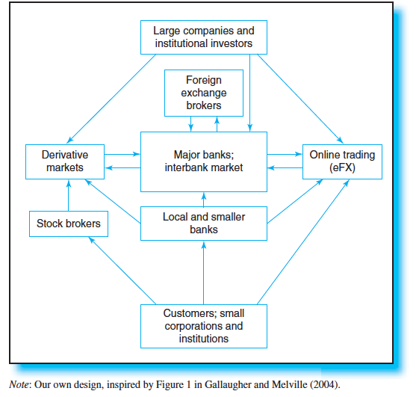
The Foreign Exchange Market
Structure of the FX Market

Slide 5
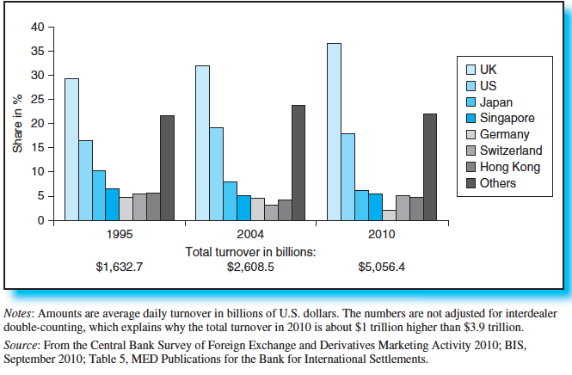
The Foreign Exchange Market
Size of the FX Market

Slide 6
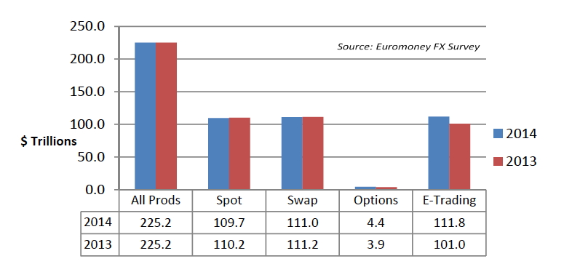
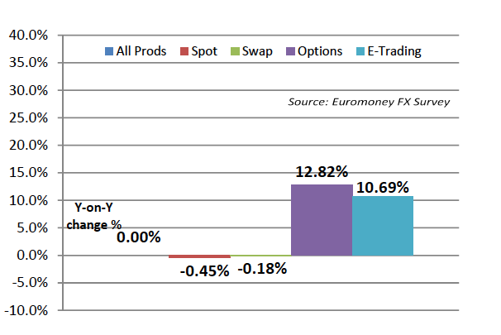
The Foreign Exchange Market
Size of the FX Market
Source: http://www.euromoney.com/Article/3331040/FX-Survey-2014-Respondent-Report.html

Slide 7
The Foreign Exchange Market
Currency quotes and prices

Slide 8
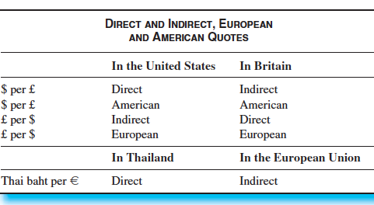
Foreign Exchange Quotes

Slide 9
Foreign Exchange Quotes
A dealer based in New York City provides a spot exchange rate quote of 12.4035 MXN/USD to a client in Mexico City. The inverse of 12.4035 is 0.0806.
From the perspective of the Mexican client, the most accurate statement is that:
A. the direct exchange rate quotation is equal to 0.0806.
B. the direct exchange rate quotation is equal to 12.4035.
C. the indirect exchange rate quotation is equal to 12.4035.

Slide 10
Foreign Exchange Quotes
B is correct. A direct exchange rate uses the domestic currency as the price currency and the foreign currency as the base currency. For an MXN/USD quote, the MXN is the price currency; therefore, the direct quote for the Mexican client is 12.4035 (it costs 12.4035 pesos to purchase one U.S. dollar).

Slide 11
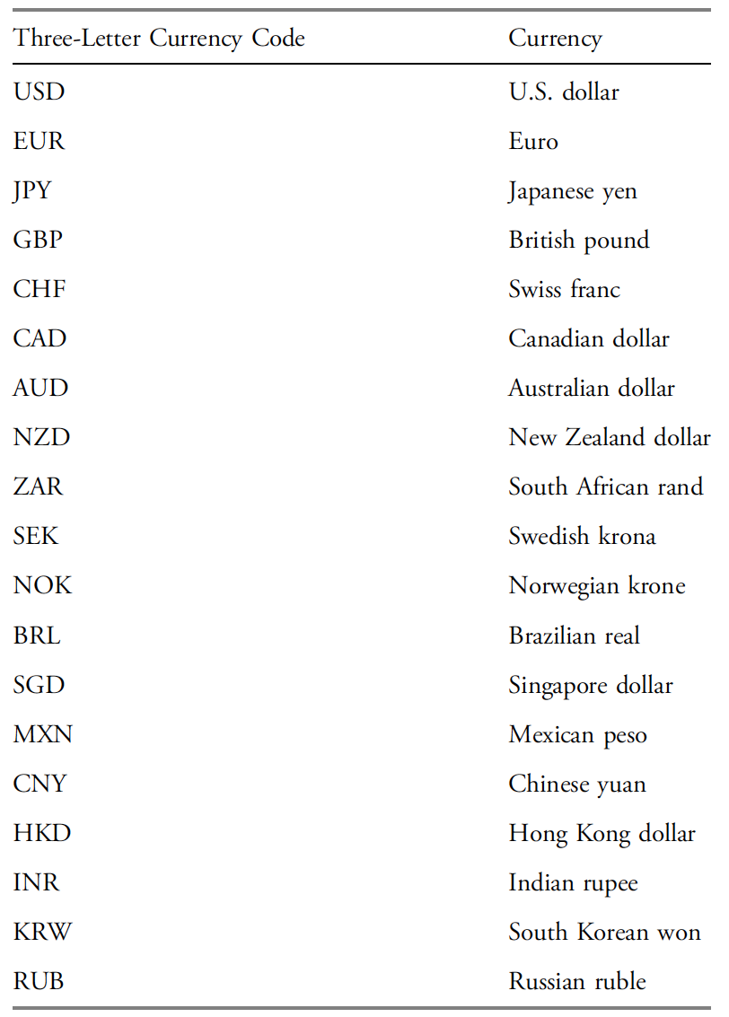
Standard codes

Slide 12
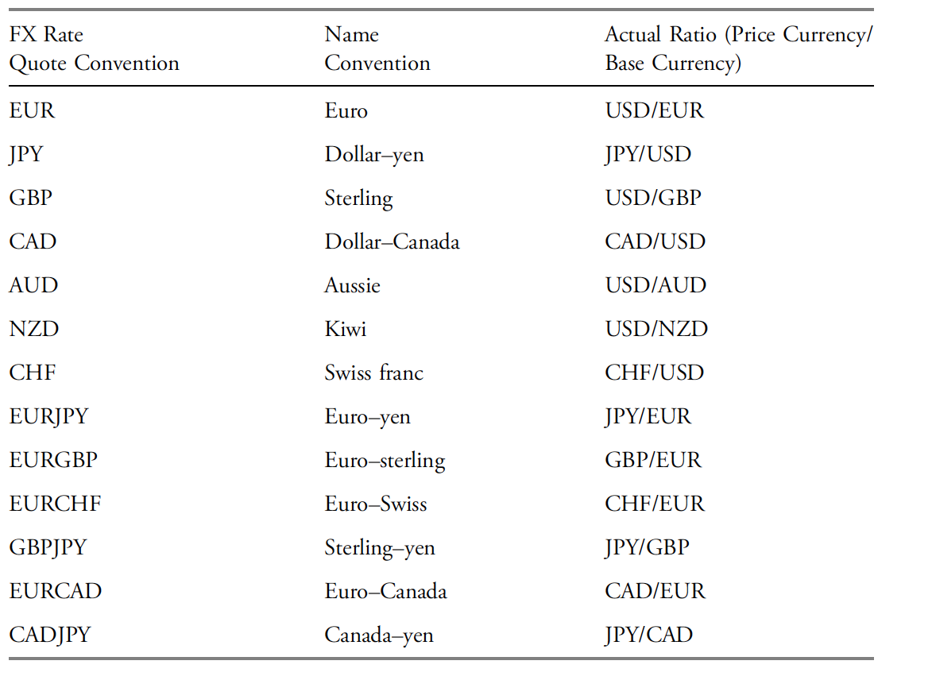
Exchange Rate Quote Conventions

Slide 13
The Foreign Exchange Market
Examples

Slide 14
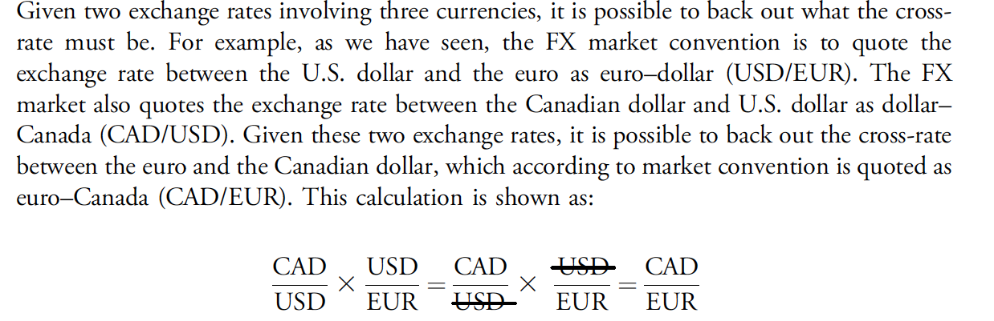
Cross-Rate Calculations

Slide 15
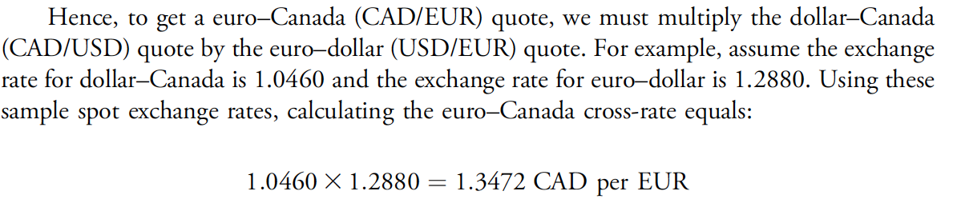
Cross-Rate Calculations

Slide 16
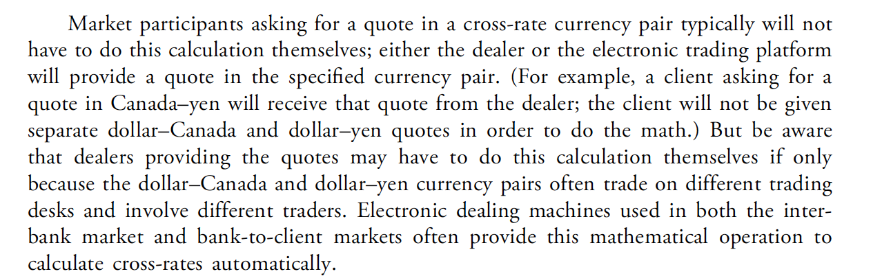
Cross-Rate Calculations

Slide 17
The Foreign Exchange Market
Triangular arbitrage

Slide 18
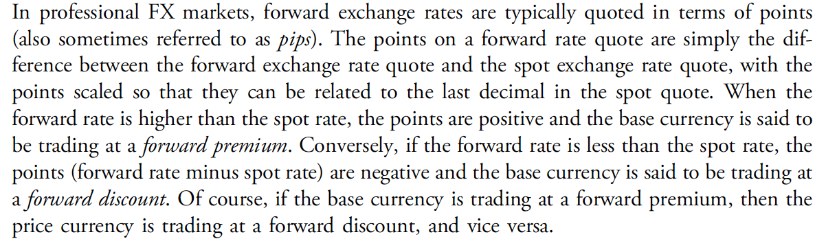
Forward Calculations

Slide 19
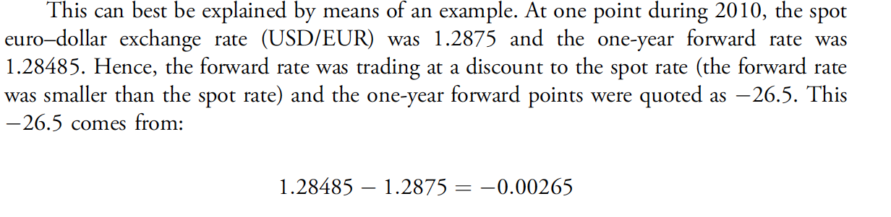
Forward Calculations

Slide 20
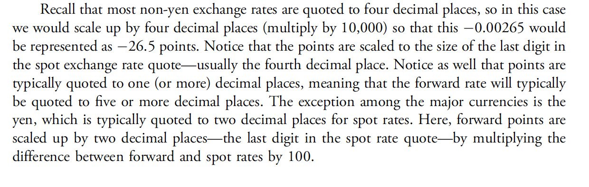
Forward Calculations

Slide 21
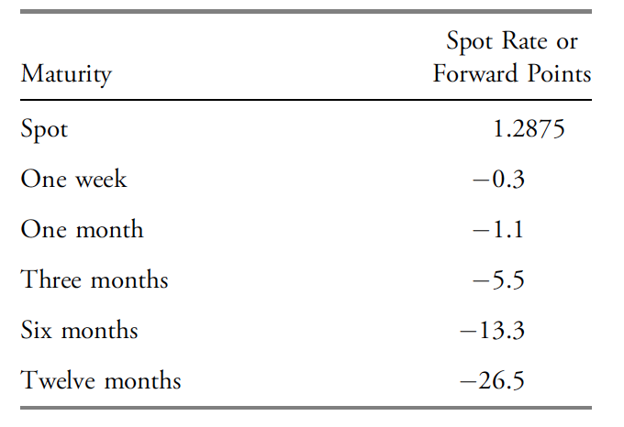
Forward Calculations

Slide 22
The Foreign Exchange Market
Bid –ask spreads

